Slide 1
WOMArt Sales
Contributor : Girish vankudre

Slide 2
Problem Statement : Predicting Store Sales
The data is available for 18 months from 365 stores of WOMart. The task is to predict the store sales for each store in the test set for the next two months.

Slide 3
Data processing steps
Loading the data and understanding the info and description of the data. No null/duplicate values identified.
There is is high correlation observed between No of Orders and Sales for the store. Thus #Order should be part of feature in order to predict the Sales.
Outliers are observed with #Order and Sales data. Techniques of regularization like RobustScaler/QuantileTrasformer/PowerTransformer/MinMaxScaler and other such transformation techniques did not provide expected results hence decided to keep outliers as it is.
Date feature has been turned into features as separate Year, Month and Date.
One Hot Encoding technique has been used to convert categorical data into numerical data for machine learning algorithm feeding. The assumed risk involved is of ‘Curse of Dimensionality’.
Assumption of Linear Regression are verified.

Slide 4
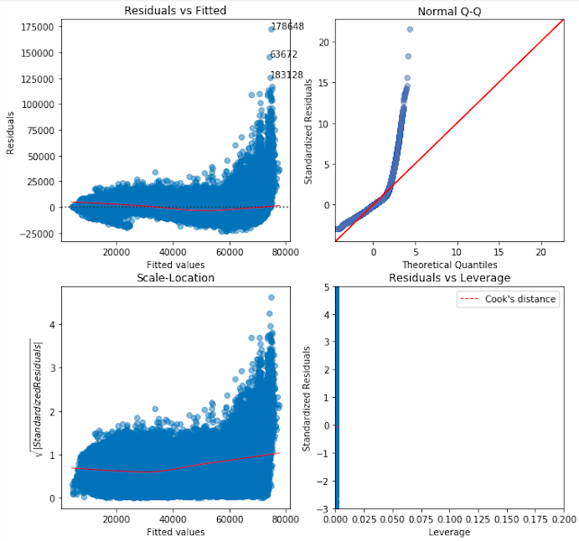
Assumptions of Linear Regression

Slide 5
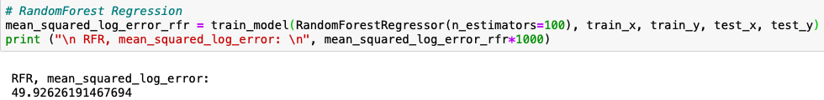
Solution Approach
Even though No of Orders is of great help while predicting Sales due to high correlation (does not mean it’s a cause and effect relation), the same details are not available for the test file which is for future months.
To address the problem statement, we have taken the help of Multioutput Regression Model (multiple target variables which are highly correlated with each other). The result of the approach is as below for train and test file. The model used is RandomForest Regressor.
The result on test data looks as below.

